Slide 1

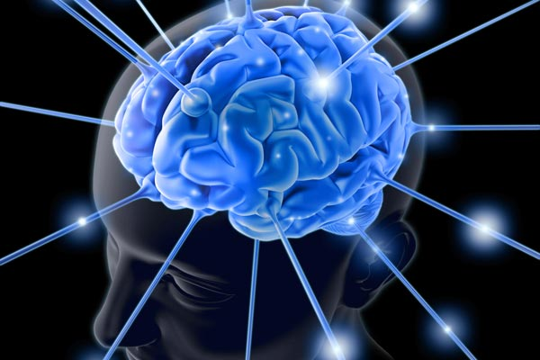
Pain and the Brain
A Biopsychosocial Approach to Pain Management
Jennifer L. Johnson, DNP, MSN, BSN, FNP-C

Slide 2
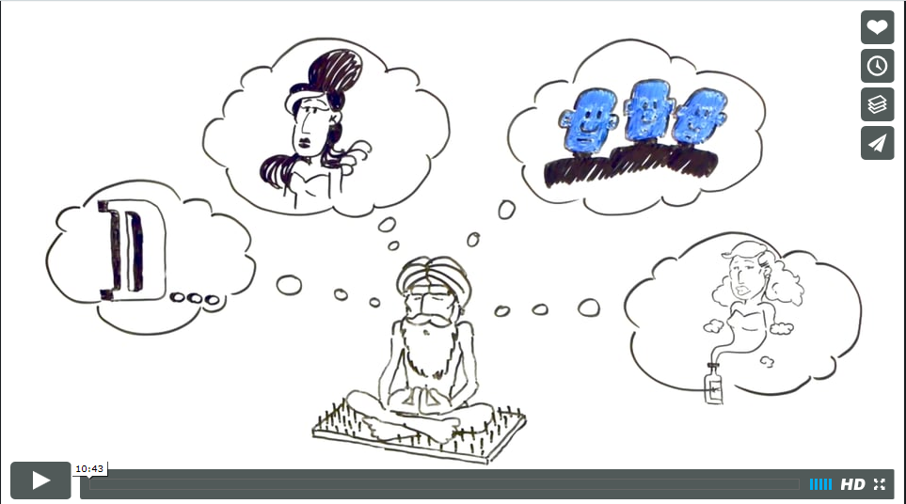

Slide 3
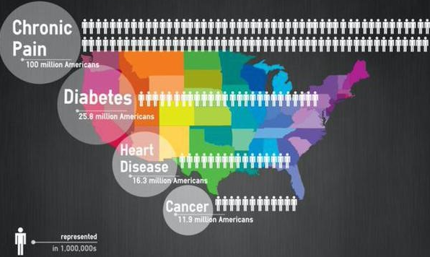
Scope of the Problem
100 Million in U.S.
with Persistent Pain
42% with pain lasting over one year
33% report pain as disabling
Second most common reason for outpatient visits
$635 Billion Annual Costs
Healthcare expenses
Lost income
Lost productivity
American Academy of Pain Medicine (2015) www.painmed.org
Institute of Medicine. 2011 Relieving Pain in America. Washington D.C.
Notes:
Chronic is prevalent. We know that approximately 100 million individuals in the US suffer from chronic pain, and that compares to 21 million with diabetes, or 19 million with coronary heart disease.
And of those people with chronic pain, many describe their pain as lasting for over a year, in fact 42-percent in this survey. And a third report their pain as being very disabling, and two-thirds have seen their primary care physician for help regarding their chronic pain.
And as you can imagine it’s costly, in the range of $600 billion in annual costs related to healthcare expenditures, lost income, and lost productivity.

Slide 4
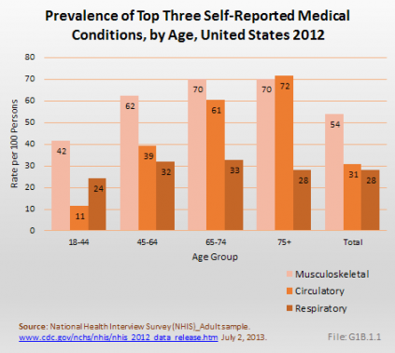

Slide 5


Background
2016, 63.1% opioid deaths related to prescription opioids
20% higher than 2010
2016, leading cause of death in United States
Usefulness of opioids for treating pain is short term
Evidence demonstrated in end of life care
Limited evidence of benefit for long term pain management
(Dowell & Haegerich, 2016; US Department of Veterans Affairs, 2016a, 2016; Burgess, Siddiqui, & Burgess, 2014; & Cheatle & Baker, 2014 Schell, 2017; Shorn, Doorenbos, Gordon and Read-Williams, 2014)
Notes:
Background
Long term opioid therapy (LTOT) is the use/prescribing of opioids for greater than three months^{3,13}. In a case cohort study conducted by the CDC, prescription drug opioid overdose accounted for 63.1% of drug related overdose death⁵. The National Institute on Drug Abuse indicated that the leading cause of death in the U.S. in 2016 was from opioid overdose killing approximately 37,886 people¹⁶. It has been stated that usefulness of the opioids for the treatment of pain is only short term and there is limited evidence of its long-term duration for the treatment of pain¹⁷. Furthermore, there has been no concrete evidence demonstrated in the safety and effectiveness of opioids for pain treatment ^{3, 13,18}. The CDC⁵ and AHRQ⁴ note that accumulated evidence reveals that there are many adverse effects of LTOT such as: addiction, abuse, accidental overdose, physical dependence, and diversion. As such, it has been suggested that LTOT risk mitigation be done regularly^{3, 4, 13}. LTOT risk mitigation includes: opioid management plans, patient education through opioid consent, frequent urine drug screens (UDS), use of prescription drug monitoring program (PDMP), use of monitoring instruments, frequent monitoring intervals, pill counts, naloxone, and limiting opioid to less than or equal to 100 morphine milligram equivalents (MME/day)
As such, it has been suggested that LTOT risk mitigation be done regularly. Long term opioid therapy risk mitigation includes: opioid management plans, patient education through opioid consent, frequent urine drug screens (UDS), use of prescription drug monitoring program (PDMP), use of monitoring instruments, frequent monitoring intervals, pill counts, naloxone, and limiting opioid to less than or equal to 100 morphine milligram equivalents (MME/day).

Slide 6
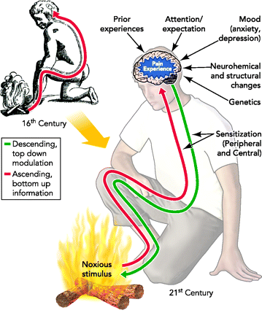
Notes:
Biomedical Model of Pain: Tissue damage and pain are directly related
Bottom-Up approach: Peripheral pain receptors relay pain signals to the brain.
But, this does not explain why, when and how much pain individuals experience and does not explain persistent pain, especially when there is no evidence of current tissue damage or underlying pathology.
Opioids treat the descending pathway. This is why we see respiratory depression frequently as a side effect.
Gabapentin, pregabalin, duloxetine, amitriptyline work on the ascending pathway.
For example: Fisher et al. in 1995 reported a case in which a 29 yo builder fell onto a 6 inch nail at a construction site. At the ER he was in such agony that the hospital staff could not even begin to remove the nail without first sedating him. When they went to go remove the nail, the staff was surprised to discover that the foot was completely uninjured and that the nail had penetrated the boot just missing his foot. This case demonstrates that the real experience of pain can be the result of threat evaluation by the brain which affect one’s perception of pain., which is modulated by prior experience (including knowledge, attitudes, beliefs, and culture), attention/expectation, mood (anxiety/depression), neurochemical and structural changes, genetics and epigenetics, and sensitization of the nervous system. All of these factors can affect one’s perception of pain.
Consider the converse situation:
In 2006 there was a study published in which 200 asymptomatic patients (i.e., no pain) underwent MRI of the spine. Despite the fact that 90% of them had some spinal abnormality, none of them reported pain.
So, tissue damage does not always equal pain, even in the acute setting.
Louis Gifford, a physiotherapist from the UK introduced a new paradigm for thinking about chronic pain in 1998. His model describes pain as an output of the brain rather than originating from damaged tissues.

Slide 7
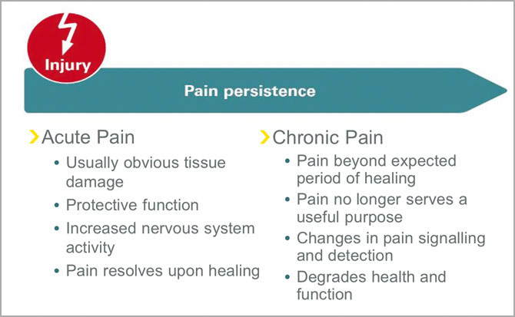
Notes:
So what is the difference between acute and chronic pain?

Slide 8
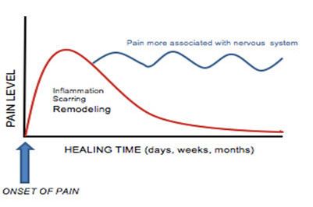
Development of Chronic Pain
Notes:
So often we explain to patients that acute pain typically diminishes with healing in days to weeks. Chronic pain is generally not a result of ongoing bone, joint or soft tissue damage, but instead represents dysregulation of the nervous system.

Slide 9
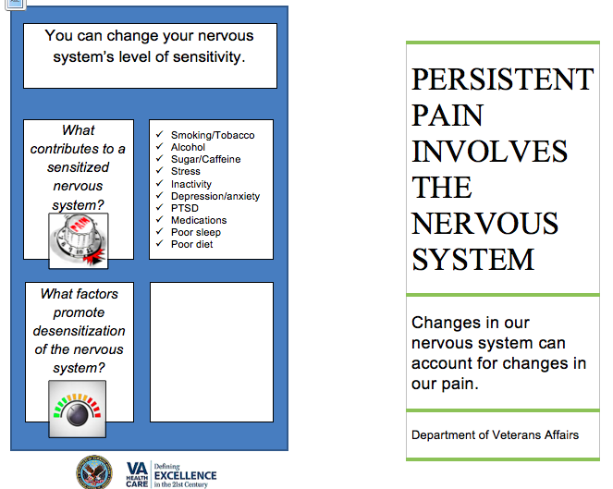
Notes:
Chronic Pain results from a nervous system that has become dysregulated. After acute inflammation, a variety of neurohormonal and epigenetic factors can trigger abnormal remodeling which creates “central sensitization” which can lead to hyperalgesia and allodynia.
This brochure is part of the VA’s effort to provide TNE or Therapeutic Neuroscience Education in the treatment of chronic pain. TNE or “Explaining Pain” classes have been shown to improve functional outcomes in patients, increase participation in active therapies for chronic pain patients, and reduce the costs of treatment for chronic pain. Unlike traditional TNE approaches, as demonstrated by this brochure, the VA emphasizes the role of mental health conditions in chronic pain education, since mental health concerns, such as PTSD, depression and SUD, are so prevalent in the veteran population and tightly associated with chronic pain conditions.

Slide 10

Prescription Opioids & Adverse Outcomes for those with Mental health disorders
Receiving prescription opioids was associated with an increased risk of adverse clinical outcomes, particularly in those with PTSD
Wounds or injuries
Opioid-related accidents and overdoses
Self-inflicted injuries/Suicide
Violence-related injuries
Seal, KH, et al. JAMA. 20127.
Notes:
These outcomes included
JAMA. 2012 Mar 7;307(9):940-7. doi: 10.1001/jama.2012.234. Association of mental health disorders with prescription opioids and high-risk opioid use in US veterans of Iraq and Afghanistan.
Seal KH, Shi Y, Cohen G, Cohen BE, Maguen S, Krebs EE, Neylan TC.
Source San Francisco VA Medical Center, University of California, San Francisco, Department of Medicine, 4150 Clement St, PO Box 111A-1, San Francisco, CA 94121, USA. karen.seal@ucsf.edu
Erratum in JAMA. 2012 Jun 20;307(23):2489.
Abstract
CONTEXT: Record numbers of Iraq and Afghanistan veterans survive their war injuries and yet continue to experience pain and mental health problems, particularly posttraumatic stress disorder (PTSD). Little is known about the association of mental health disorders and prescription opioid use.
OBJECTIVE: To investigate the effect of mental health disorders, particularly PTSD, on risks and adverse clinical outcomes associated with prescription opioid use.
DESIGN: Retrospective cohort study involving 141,029 Iraq and Afghanistan veterans who received at least 1 non-cancer-related pain diagnosis within 1 year of entering the Department of Veterans Affairs (VA) health care system from October 1, 2005, through December 31, 2010.
MAIN OUTCOME MEASURES: Independent association of mental health disorders and the prescription of opioids, higher risk opioid use, and adverse clinical outcomes (eg, accidents and overdose) within 1 year of receiving a pain-related diagnosis.
RESULTS: A total of 15,676 veterans were prescribed opioids within 1 year of their initial pain diagnosis. Compared with 6.5% of veterans without mental health disorders, 17.8% (adjusted relative risk [RR], 2.58; 95% CI, 2.49-2.67) of veterans with PTSD and 11.7% (adjusted RR, 1.74; 95% CI, 1.67-1.82) with other mental health diagnoses but without PTSD were significantly more likely to receive opioids for pain diagnoses. Of those who were prescribed pain medication, veterans with PTSD were more likely than those without mental health disorders to receive higher-dose opioids (22.7% vs 15.9%, adjusted RR, 1.42; 95% CI, 1.31-1.54), receive 2 or more opioids concurrently (19.8% vs 10.7%, adjusted RR, 1.87; 95% CI, 1.70-2.06), receive sedative hypnotics concurrently (40.7% vs 7.6%, adjusted RR, 5.46; 95% CI, 4.91-6.07), or obtain early opioid refills (33.8% vs 20.4%; adjusted RR, 1.64; 95% CI, 1.53-1.75). Receiving prescription opioids (vs not) was associated with an increased risk of adverse clinical outcomes for all veterans (9.5% vs 4.1%; RR, 2.33; 95% CI, 2.20-2.46), which was most pronounced in veterans with PTSD.
CONCLUSION: Among US veterans of Iraq and Afghanistan, mental health diagnoses, especially PTSD, were associated with an increased risk of receiving opioids for pain, high-risk opioid use, and adverse clinical outcomes.
Comment in
Posttraumatic stress disorder and opioid use among US veterans. [JAMA. 2012]
PMID: 22396516

Slide 11
Chronic Pain and PTSD: Mutual Maintenance
Disability
Pain
Anxiety/hyperarousal – pain perception
PTSD re-experiencing - evokes pain
Dysregulated ANS/Endog. Opioid system
PTSD
Anxiety
Adapted from Sharp TJ, Harvey AG. Clin Psychol Rev. 2001 Aug;21(6):857-77.
Notes:
This graphic adapted from Sharp and Harvey takes a closer look at how mood, in this case PTSD and related anxiety, can heighten the perception of pain which can increase disability, which, in turn, can exacerbate avoidance which is a hallmark symptom of PTSD. Unfortunately, therefore, PTSD and pain can mutually reinforce and maintain each other unless the cycle is interrupted. Depression and other mood disorders can also increase the perception of pain.
Adapted from Sharp and Harvey, 2001

Slide 12
Biomedical Management of Chronic Pain

Slide 13
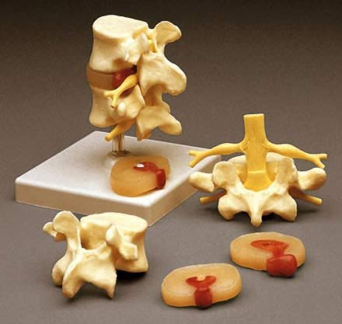
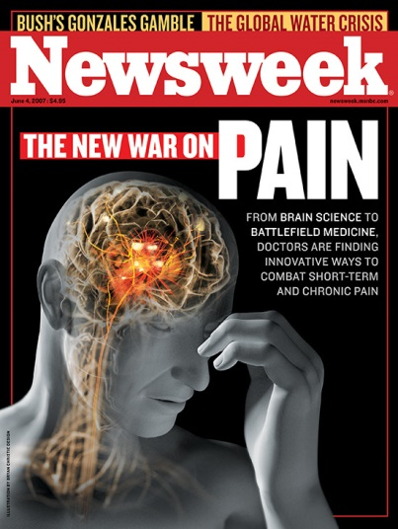
BIOMEDICAL Model OF Pain Care
Diagnostics to ID singular cause of pain
Interventions target peripheral tissues
Mind and body are separate
Passive interventions
Primarily mono-therapies
“Kill the Pain”
We can fix it!
Complete pain relief is possible!
Butler, Neuro Orthopedic Institute WCPT 2011
Notes:
This is the model we use most often in medicine, despite all that neuroscience has taught us about pain in the last decade.
Numerous studies confirm that degenerative spines and collapsed disc spaces do not predict back pain, yet we all still use models like these to explain the pain.
Specifically, these models communicate that mind and body are separate when it comes to pain, that we have to figure out the single biological source of the pain and fix it. Unfortunately, the message is that chronic pain can be fixed and that complete relief is possible.

Slide 14
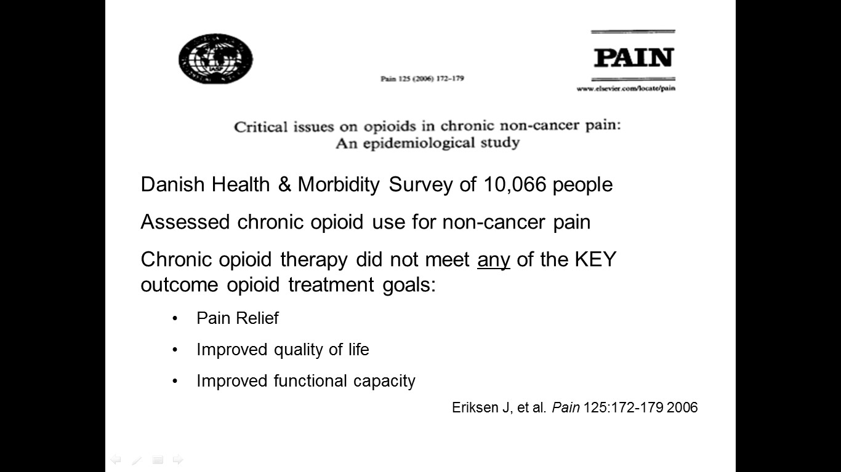
BUT…..Are Opioids Really Effective Against Pain?

Slide 15
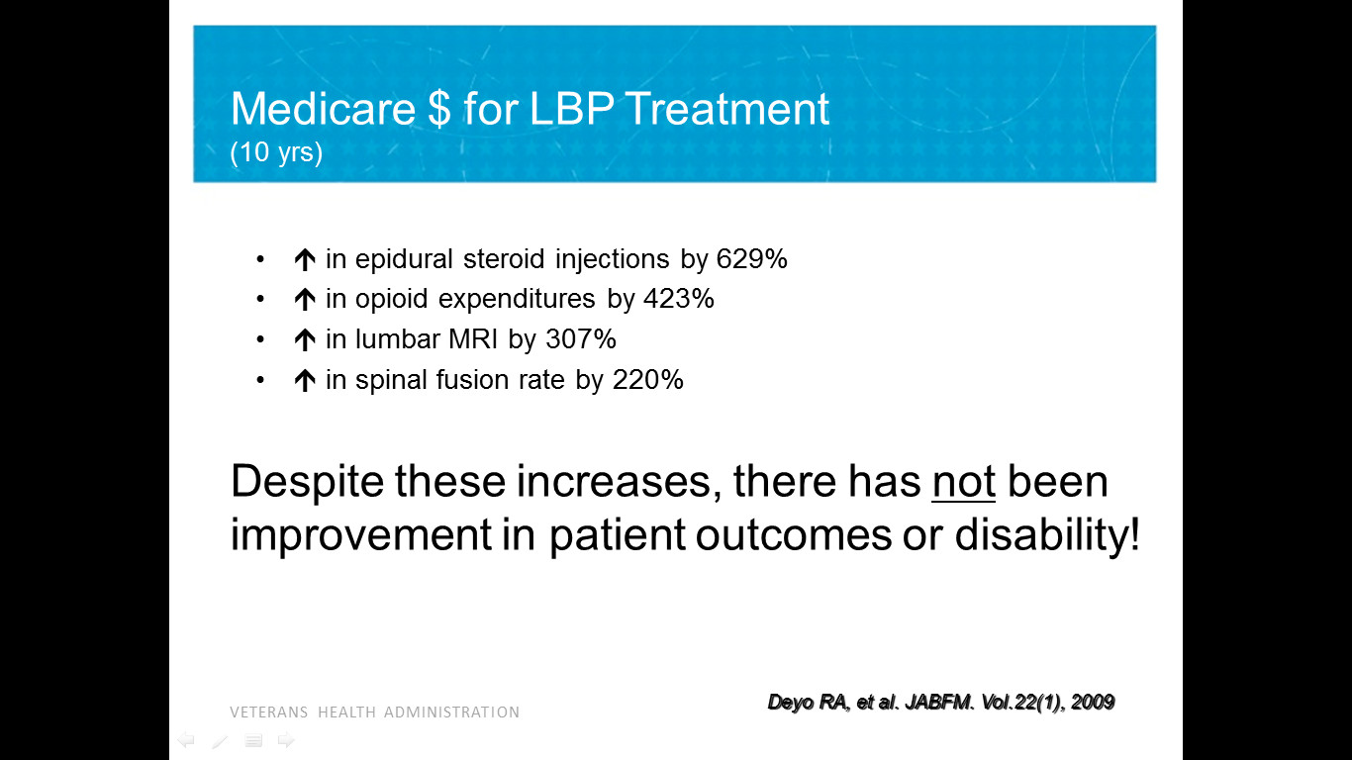
Notes:
This slide shows Medicare expenditures for lower back pain treatment and demonstrates the staggering increases in procedures, diagnostics and costs over 10 years. The publication also points out the sad truth that despite all of these expenditures for procedures and diagnostics that there have been no demonstrable improvements in patient outcomes or disability.

Slide 16
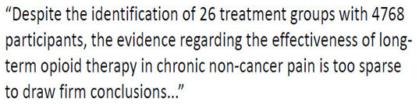
Noble, M. The Cochrane Collaboration. 2010

Slide 17
ANESTHESIOLOGY® 2016 annual meeting
In the study, 2,030 people with low back pain completed a survey about treatment.
Nearly half (941) were currently taking opioids.
When asked how successful the opioids were at relieving their pain, only 13 percent said “very successful.” The most common answer – given by 44 percent – was “somewhat successful” and 31 percent said “moderately successful.” Twelve percent said “not successful.”
Seventy-five percent said they experienced side effects including constipation (65 percent), sleepiness (37 percent), cognitive issues (32 percent) and dependence (29 percent).

Slide 18
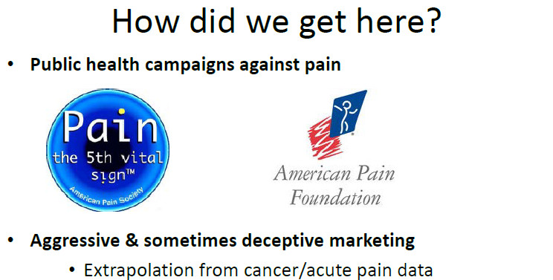
Notes:
Unfortunately, a lot of this marketing was to medical students and trainees and whole CME courses were sponsored by pharmaceutical companies.

Slide 19
Opioids and chronic pain-Risks v. Benefits
Uncertain Benefits:
? Pain relief
? Improved physical functioning, QOL
Potential known harms:
Fatal overdose
Tolerance/physical dependence
Addiction/abuse/diversion
Respiratory depression--avoid in COPD
Cognitive impairment--avoid in dementia
Endocrine disruption- ED, muscle wasting, fatigue, OP
Sleep disturbances; worsening sleep apnea
Hyperalgesia on higher dose opioids

Slide 20
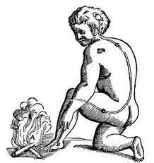
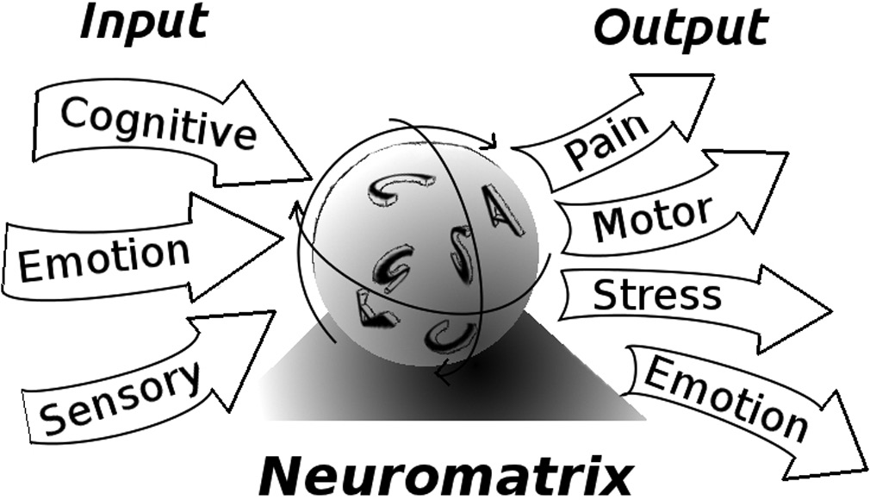
Cultural transformation in the way pain is viewed, assessed, and treated
Biomedical To Biopsychosocial Model
Notes:
Shift from biomedical model to biopsychosocial model.
An assessment of persistent pain that is solely focused on identifying the pain generator will likely lead to frustration for both the patient and the provider.
All pain has cognitive, sensory, and emotional influences and behavioral manifestations. Meaning/spirituality influences the pain experience. Assessment must focus on sensory, cognitive, emotional, behavioral and spiritual influences and effects.

Slide 21
Biopsychosocial Model of Pain
PAIN
Not just a symptom
but your patient’s lived experience
Pain
Functional Disability
Psycho-social
Notes:
Understanding that pain originates in the brain and not simply through peripheral nerve stimulation marks an important shift in thinking. Recognizing that the brain’s evaluation of potential threat is the most important potential target for modulating the experience of pain. Helping patient’s to understand reasons for their experience of chronic pain is called “explaining pain” and is an educational technique used by physical therapist and pain specialists to shift the locus from the biomedical “we can find it and fix it” to the biopsychosocial and integrative model of chronic pain self-management. This technique of explaining pain has been shown to improve functional outcomes, reduce depression, decrease fear-avoidance behavior and increase participation in active therapies for chronic pain patients.

Slide 22

Goals of Chronic Pain Management
Restore functioning
Improve quality of life
Reduce pain
“A car with four flat tires”
Medications only fill one tire
Notes:
The goal of chronic pain management is NOT to eliminate pain. We certainly try to reduce pain, but we don’t make that our endpoint. The primary goals are to restore functioning, and improve quality of life. We want to help our patients engage in the things that are most important to them.
To do that, we need the appropriate tools. In our pain groups, we explain that a person with chronic pain is like a car with 4 flat tires. Medication can fill one of those tires, but if that’s all you have you still won’t go anywhere. In other words, for chronic pain management to be effective, a multi-modal approach is best.

Slide 23
MultiMODAL Chronic Pain Care
Gentle exercise
Manual therapies
Acupuncture
Yoga, Chigong
Others
CBT
Mood/trauma therapies
Substance abuse Tx
Sleep Hygiene
Meditation/Relaxation
Physical
Behavioral
SELF
MGT
Medication
Procedural
NSAIDS
Anticonvulsants
Antidepressants
Topical agents
Others
Nerve blocks/ablation
Steroid injections
Trigger point injections
Stimulators
Notes:
Inform the patient: The gold standard of care for chronic pain is a comprehensive approach, integrating medical procedures where indicated, with physical rehabilitation and any adjunctive txs with minimal SEs, and behavioral retraining.
The best chance of success is when the patient becomes the expert manager of his own pain plan. When we talk to patients about self-management of their pain program, we remind them that coping skills are a first-line tx for any chronic illness.
For many patients with chronic pain, combining PT, cognitive behavioral therapy, daily gentle exercise and relaxation and meditation techniques may be sufficient to reduce their pain. If opioids are needed, we often find that pts’ response and ability to manage their meds is better when they have a comprehensive program to self-manage pain.

Slide 24

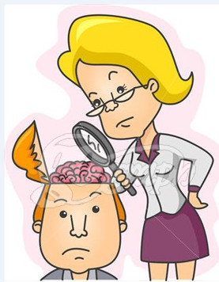



Multidisciplinary Approach
Biopsychosocial Model
Optimize non-opioid pain care; decrease opioid risk
Improve function and QOL
Gatchel et al., 2014; Wiedemer et al., 2007; Dorflinger et al., 2014; VA DoD 2017, CDC 2016

Slide 25
Growing Evidence base
Integrative Chronic Pain Care

Slide 26
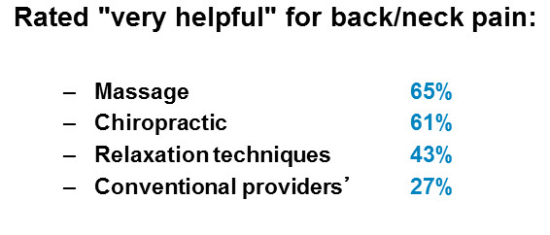
integrative modalities for pain
Safer in patients with comorbidities and polypharmacy
30-50% of veterans use CAM/Integrative modalities;
only 1/3 disclose to their PCPs Smeeding et al., 2016
Integrative modalities for pain are NOT available at many VA’s despite patient preference for CAM.
We can request through Veteran’s Choice Program.
Notes:
Fargo VA
Tia chi
Manual Therapy
Yoga
Health Net
- Chiropractic care
- Acupuncture

Slide 27
Integrative (CAM) therapies—pain
National Center for Complimentary and Integrative Health http://nccam.nih.gov/health/pain/chronic.htm?nav=gsa
Notes:
Complementary Approaches. For chronic pain, evidence base is strongest for the use of the following treatments: Acupuncture (limited to moderate evidence)
Yoga (limited evidence)
Massage (limited to moderate evidence)
MINDFULNESS: THERAPIES focus on becoming aware of all incoming thoughts and feelings and accepting them, but not attaching or reacting to them

Slide 28
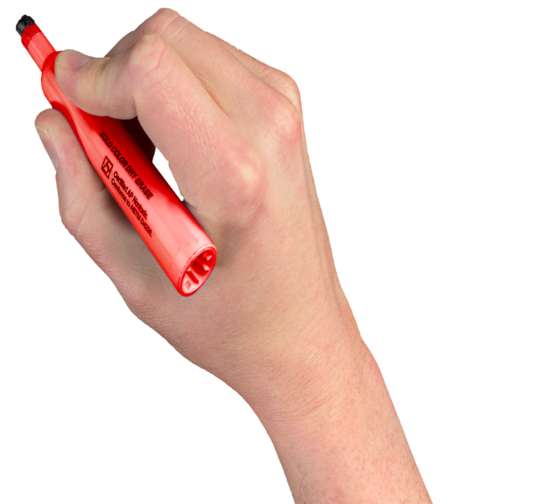
Additional Focus
Safe opioid prescribing through risk mitigation at time of refill
Accidental Overdose death in Veterans 47% higher
(Bohnert, Ilgen, Galea, et al, 2011and Bohnert, Valenstein, Bair, et al. 2011)
Notes:
Problem Statement
Safe opioid prescribing practice change has been a priority for the Veterans Health Administration (VHA). It has been estimated that the rate of accidental opioid overdose in veterans was 47% higher per 100,000 person-years^{6,7}. The Fargo Veterans Administration Health Care System (VAHCS) in-line with the VHA seeks to reduce harm from unsafe medications and/or excessive doses while adequately controlling pain in veterans^{3,8, 9, 10, 11}. Opioid risk mitigation for a veteran on long term opioid therapy (LTOT) can be monitored with an opioid renewal note template within the Fargo VAHCS.
Frequent and regular opioid safety monitoring can assist in safer opioid prescribing. It has been suggested that LTOT monitoring includes: monthly to quarterly documentation of risk evaluation, less than 100 milligram morphine equivalence per day (MME/day) dosing, frequent diagnostics such as urine drug screens (UDS), regular state prescription drug monitoring program (PDMP) review, and naloxone distribution^{3, 12, 13, 14, 15}

Slide 29
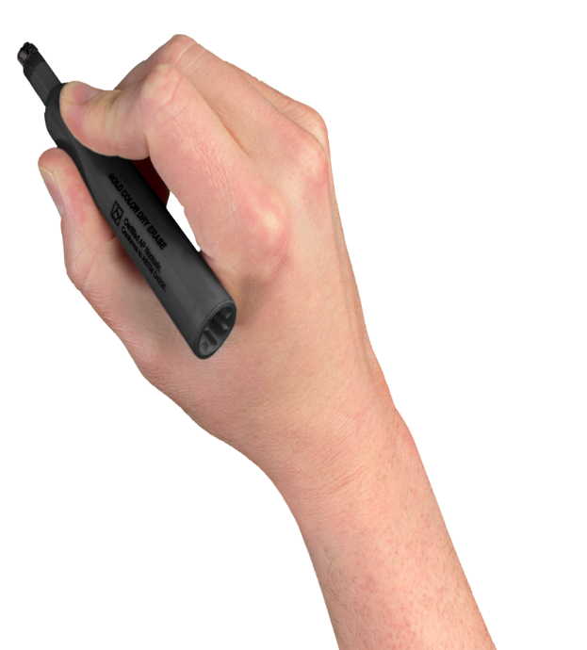
A Practical Opioid Rx Solution
Opioid Risk Mitigation
Date of last prescription drug monitoring check
Last urine drug screen
Medication list
Clinic visits dates
Consent to long term opioid therapy management
Acknowledges discussion, education, and understanding of risk to benefit
Notes:
data objects such as the date of last state prescription drug monitoring program (PDMP) note, last urine drug screen (UDS), medication list, three-month period of clinic visits, and if long term opioid therapy (LTOT) consent is present, hence providing safer care. Frequent and constant monitoring through an opioid renewal template note can assist in deciding whether to continu, restructure or discontinue opioid therapy based on risk mitigation.

Slide 30

“Motion is the Lotion”

Slide 31
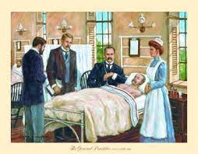
The good physician treats the disease; the great physician treats the patient who has
the disease. -Sir William Osler, circa 1900
Notes:
FACILITATOR NOTES:
Sir William Osler pioneered bedside teaching rounds

Slide 32
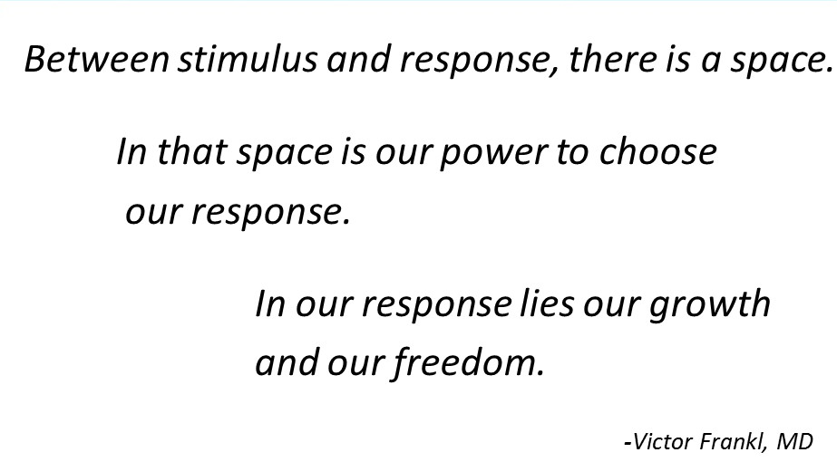

Slide 33
Special Thanks!!
QUESTIONS?

