Slide 1
Integrative Care – An Essential Component for Patient Quality of Life

Slide 2
Integrative oncology is a patient-centered, evidence-informed field of cancer care that utilizes mind and body practices, natural products, and/or lifestyle modifications from different traditions alongside conventional cancer treatments. Integrative oncology aims to optimize health, quality of life, and clinical outcomes across the cancer care continuum and to empower people to prevent cancer and become active participants before, during, and beyond cancer treatment. -Society for Integrative Oncology

Slide 3
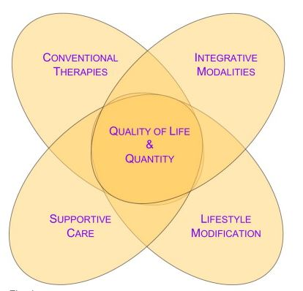

Slide 4
A brief look at a complicated history…
Shamans
Ayurveda- 2,500 BCE
Traditional Chinese Medicine- 1,600 BCE
Cartesian dualism, made famous by Rene Descartes, 1596–1650 – mind and body are separate
Biomedical model- Newton
“The Flexner Report of 1910 transformed the nature and process of medical education in America with a resulting elimination of proprietary schools and the establishment of the biomedical model as the gold standard of medical training.” (Duffy)
Florence Nightingale (1820-1910)- Environmental theory, relational healing
Herbert Benson- 1970s
Jon Kabat-Zinn- 1970s
Andrew Weil- 1994

Slide 5
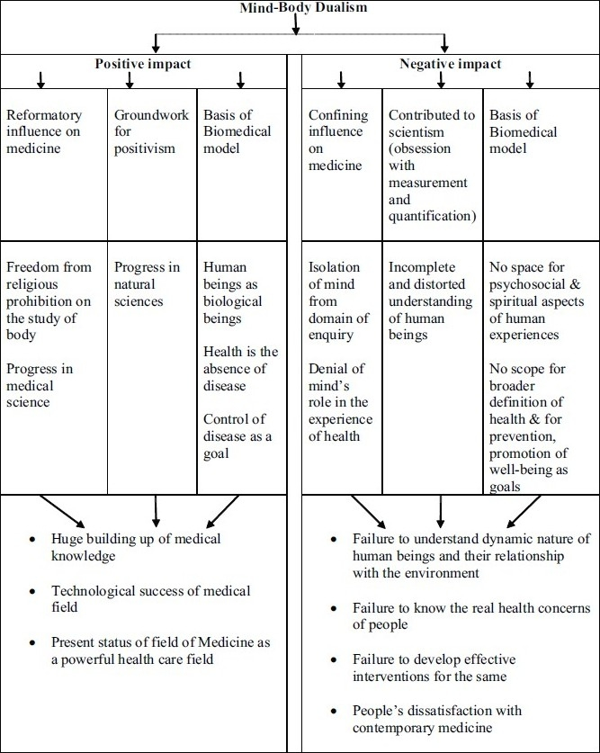
(Mehta)

Slide 6
“The IOM report on CAM further documented growing use of CAM. One third of American adults were using some form of CAM, with total annual visits to CAM providers exceeding visits to primary care physicians, and an estimated 15 million adults were taking herbal remedies and vitamins in addition to prescription drugs.” (Maizes)
“The American Hospital Association found that US hospitals are increasingly adding CAM to conventional services; 37% of responding hospitals now offer one or more CAM therapies, up from 26.5% in 2005. Eighty-four percent of the hospitals indicated patient demand as the primary reason for offering the alternative therapies, while 67% stated clinical effectiveness as the main reason.” (Maizes)
M. D. Anderson, Dana-Farber, Memorial Sloan-Kettering, Duke, and Columbia University

Slide 7
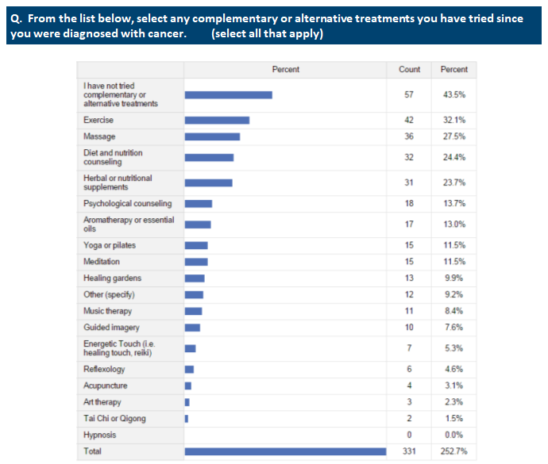
Sanford, 2016

Slide 8
Yoga
Acupuncture and Chinese medicine
Acupressure
Meditation and mindfulness
Massage therapy
Reflexology
Energy work (Reiki, Healing Touch, etc)
Ayurveda
Chiropractor
Naturopathic medicine
Art therapy
Music therapy
Aromatherapy
Hypnotherapy
Guided Imagery
Biofeedback
Breathing exercises
Exercise
Tai Chi
Counseling/therapy
Osteopathy
Spiritual support
This is why teamwork is so important!

Slide 9
An example of an Integrative Care Team:
Physician (medical oncology, radiation, surgery, etc)
Psychologist/counselor
Nutritionist
Acupuncturist
Hypnotherapist/Meditation teacher/Mindfulness coach
Massage Therapist
Chaplain

Slide 10
In a multicenter study of 410 predominantly breast cancer patients using a program of breathing exercises, 18 gentle yoga postures, and meditation, significant improvements were seen in sleep quality, fatigue, and QoL. (Mustian)
In the largest prospective observational study of massage therapy, researchers in a major cancer center treated 1,290 cancer patients with Swedish massage, reflexology/foot massage, or light touch massage and found clinically relevant improvement in multiple areas including pain (improved by 48%), fatigue (43%), stress/anxiety (60%), nausea (51%), and depression (36%). (Cassileth)
Systematic literature review from 1990 through 2015: High levels of evidence support the routine use of mind-body practices, such as yoga, meditation, relaxation techniques and passive music therapy to address common mental health concerns among breast cancer patients, including anxiety, stress, depression, and mood disturbances. Additionally, meditation has been shown to improve quality of life and physical functioning, and yoga has been found to improve quality of life and fatigue. Massage has been shown to improve mood... Given the high level of evidence of benefit coupled with the and the relative low level of risk, these therapies can be incorporated as an option care for patients, especially when there is poor symptom control. (Greenlee, et al)

Slide 11
Integrative modalities used alongside conventional treatment can help create the most optimal environment for the body to utilize it’s innate healing ability
Whole person medicine and patient centered care- people are more than their physical body
Looking at lifestyle in order to prevent disease
Patient and practitioner are partners in the healing process
Teamwork and coordinated care

Slide 12
How can Integrative Care help?
Improve quality of life
“A recent meta-analysis using 30 randomized controlled trials from the European Organization for Research and Treatment of Cancer, which included survival data for over 10,000 patients with 11 different cancer sites found that QoL is predictive of survival.” (Quinten)
Symptom management
Pain, fatigue, anxiety, stress, depression, insomnia, poor appetite, irritability, nausea, worry, etc
Active participation- patient can be “doing something”
Integrative care can help support all parts of the patient- body, mind, and spirit
Prevention

Slide 13
Stress and cancer
Stress is the perception of a threat to the physical or psychological well-being of a person & the perception that the person’s responses are inadequate to cope with it.
Stress vs. Chronic Stress
Weakened immune system.
Unmanaged stress can lead to behaviors that are linked to cancer such as smoking, overeating, no exercise, or drinking alcohol.
During and after treatment, untreated stress can lead to: depression, anxiety, overall lower quality of life.

Slide 14
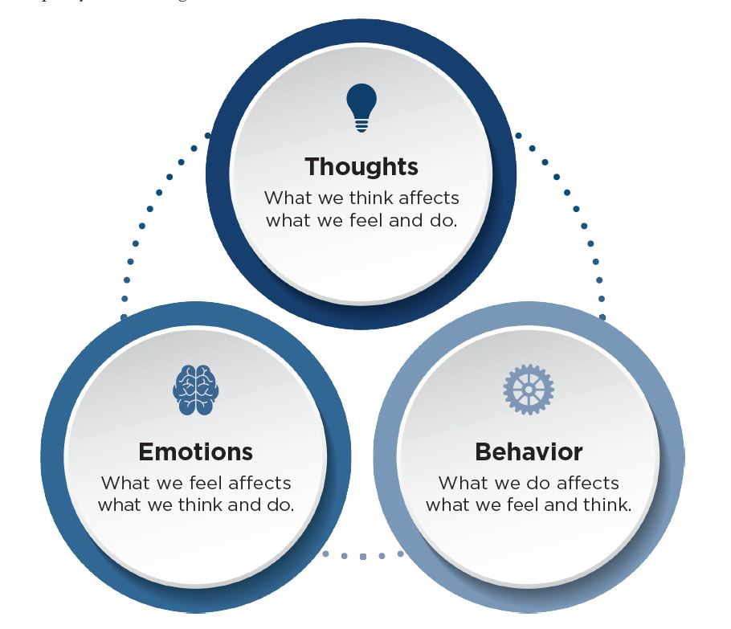

Slide 15
How you can bring more integrative care into your practice:
Take care of yourself!
Listen. Offer options when possible.
A study looking at “placebo effects can experimentally be separated into the response to three components-assessment and observation, a therapeutic ritual (placebo treatment), and a supportive patient-practitioner relationship-and then progressively combined to produce incremental clinical improvement in patients with irritable bowel syndrome… The proportion of patients reporting adequate relief showed a similar pattern: 28% on waiting list, 44% in limited group, and 62% in augmented group (P<0.001 for trend). The same trend in response existed in symptom severity score (30 (63) v 42 (67) v 82 (89), P<0.001) and quality of life (3.6 (8.1) v 4.1 (9.4) v 9.3 (14.0), P<0.001). All pairwise comparisons between augmented and limited patient-practitioner relationship were significant: global improvement scale (P<0.001), adequate relief of symptoms (P<0.001), symptom severity score (P=0.007), quality of life (P=0.01). Results were similar at six week follow-up.” (Kaptchuk, et al)
Studies show that patient centered care enhanced patient satisfaction, better outcomes, improved health status, and reduced utilization of care. It also leads to enhanced practitioner satisfaction and lower malpractice rates. (Maizes, et al)
Referrals to other integrative team members, if possible.

Slide 16
Some places you can go to learn more:
UMass Memorial Health Care Center for Mindfulness, 1970’s
American Holistic Medical Association, 1978
American Holistic Nurses Association, 1981
Arizona Center for Integrative Medicine, 1994
The Consortium of Academic Health Centers for Integrative Medicine (CAHCIM), 2000
Society for Integrative Oncology, 2003
Academic Consortium for Complementary and Alternative Healthcare (ACCAHC), 2004
Duke Integrative Medicine, 2006
Benson-Henry Institute, 2006

Slide 17
Barriers to Integrative Care growth:
Research
Education
Provider time
Insurance

Slide 18
Cassileth B.R., Vickers A.J.: Massage therapy for symptom control: outcome study at a major cancer center. J Pain Symptom Manage 2004; 28: pp. 244-249.
Claudia M. Witt, Lynda G. Balneaves, Maria J. Cardoso, Lorenzo Cohen, Heather Greenlee, Peter Johnstone, Ömer Kücük, Josh Mailman, Jun J. Mao, A Comprehensive Definition for Integrative Oncology, JNCI Monographs, Volume 2017, Issue 52, November 2017, lgx012, https://doi.org/10.1093/jncimonographs/lgx012
Duffy, Thomas. The Flexner Report ― 100 Years Later. Yale J Biol Med. 2011 Sep; 84(3): 269–276.
Greenlee H, DuPont-Reyes MJ, Balneaves LG, Carlson LE, Cohen MR, Deng G, Johnson JA, Mumber M, Seely D, Zick SM, Boyce LM, Tripathy D. Clinical practice guidelines on the evidence-based use of integrative therapies during and after breast cancer treatment. CA Cancer J Clin. 2017 May 6;67(3):194-232. doi: 10.3322/caac.21397. Epub 2017 Apr 24. PMID: 28436999; PMCID: PMC5892208.
Kaptchuk TJ, Kelley JM, Conboy LA, Davis RB, Kerr CE, Jacobson EE, Kirsch I, Schyner RN, Nam BH, Nguyen LT, Park M, Rivers AL, McManus C, Kokkotou E, Drossman DA, Goldman P, Lembo AJ. Components of placebo effect: randomised controlled trial in patients with irritable bowel syndrome. BMJ. 2008 May 3;336(7651):999-1003. doi: 10.1136/bmj.39524.439618.25. Epub 2008 Apr 3. PMID: 18390493; PMCID: PMC2364862.
Maizes V, Rakel D, Niemiec C. Integrative medicine and patient-centered care. Explore (NY). 2009 Sep-Oct;5(5):277-89. doi: 10.1016/j.explore.2009.06.008. PMID: 19733814.
Mehta, Neeta. Mind-Body Dualism: A critique from a Health Perspective. Mens Sana Monogr. 2011 Jan-Dec; 9(1): 202–209. doi: 10.4103/0973-1229.77436
Moreno-Smith, M., Lutgendorf, S., Sood, A. Impact of stress on cancer metastasis. Future Oncol. 2010 Dec; 6(12): 1863–1881. doi: 10.2217/fon.10.142
Mustian K.M., Palesh O., Sprod L.: Effect of YOCAS yoga on sleep, fatigue, and quality of life: A URCC CCOP randomized, controlled clinical trial among 410 cancer survivors. ASCO Meeting Abstracts 2010; 28: 9013
Obradović MMS, Hamelin B, Manevski N, Couto JP, Sethi A, Coissieux MM, Münst S, Okamoto R, Kohler H, Schmidt A, Bentires-Alj M. Glucocorticoids promote breast cancer metastasis. Nature. 2019 Mar;567(7749):540-544. doi: 10.1038/s41586-019-1019-4. Epub 2019 Mar 13. PMID: 30867597.
Partecke LI, Speerforck S, Käding A, Seubert F, Kühn S, Lorenz E, Schwandke S, Sendler M, Keßler W, Trung DN, Oswald S, Weiss FU, Mayerle J, Henkel C, Menges P, Beyer K, Lerch MM, Heidecke CD, von Bernstorff W. Chronic stress increases experimental pancreatic cancer growth, reduces survival and can be antagonised by beta-adrenergic receptor blockade. Pancreatology. 2016 May-Jun;16(3):423-33. doi: 10.1016/j.pan.2016.03.005. Epub 2016 Mar 23. PMID: 27083074.
Pineda MJ, Singh DK. What is integrative oncology and can it help my patients? Obstet Gynecol Clin North Am. 2012 Jun;39(2):285-312. doi: 10.1016/j.ogc.2012.03.001. PMID: 22640716.
Quinten C., et al: Baseline quality of life as a prognostic indicator of survival: a meta-analysis of individual patient data from EORTC clinical trials. Lancet Oncol 2009; 10: pp. 865-871
Richard P. PetriJr., Roxana E. Delgado, and Kimberly McConnell.Medical Acupuncture.Oct 2015.309-317.http://doi.org/10.1089/acu.2015.1120

